Slide 1
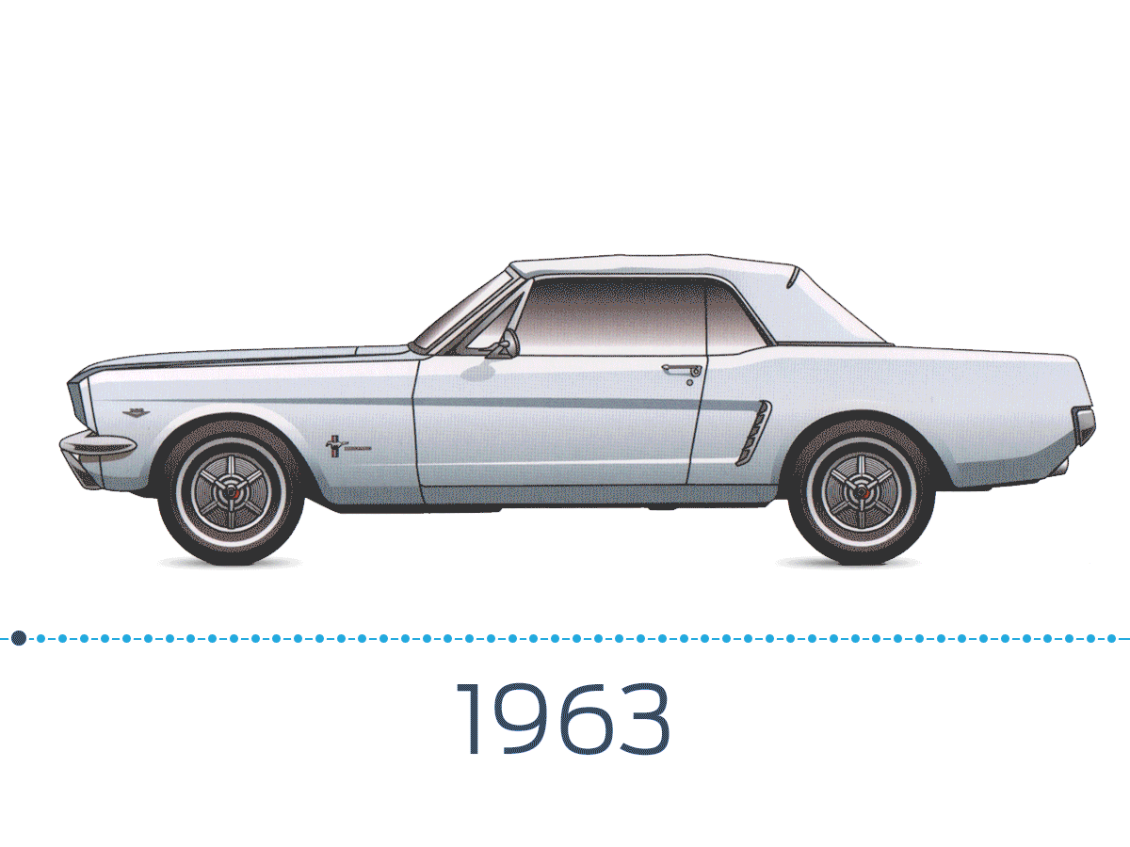

Slide 2


Group #10:
Ankit Singh
12/09/2019

Slide 3

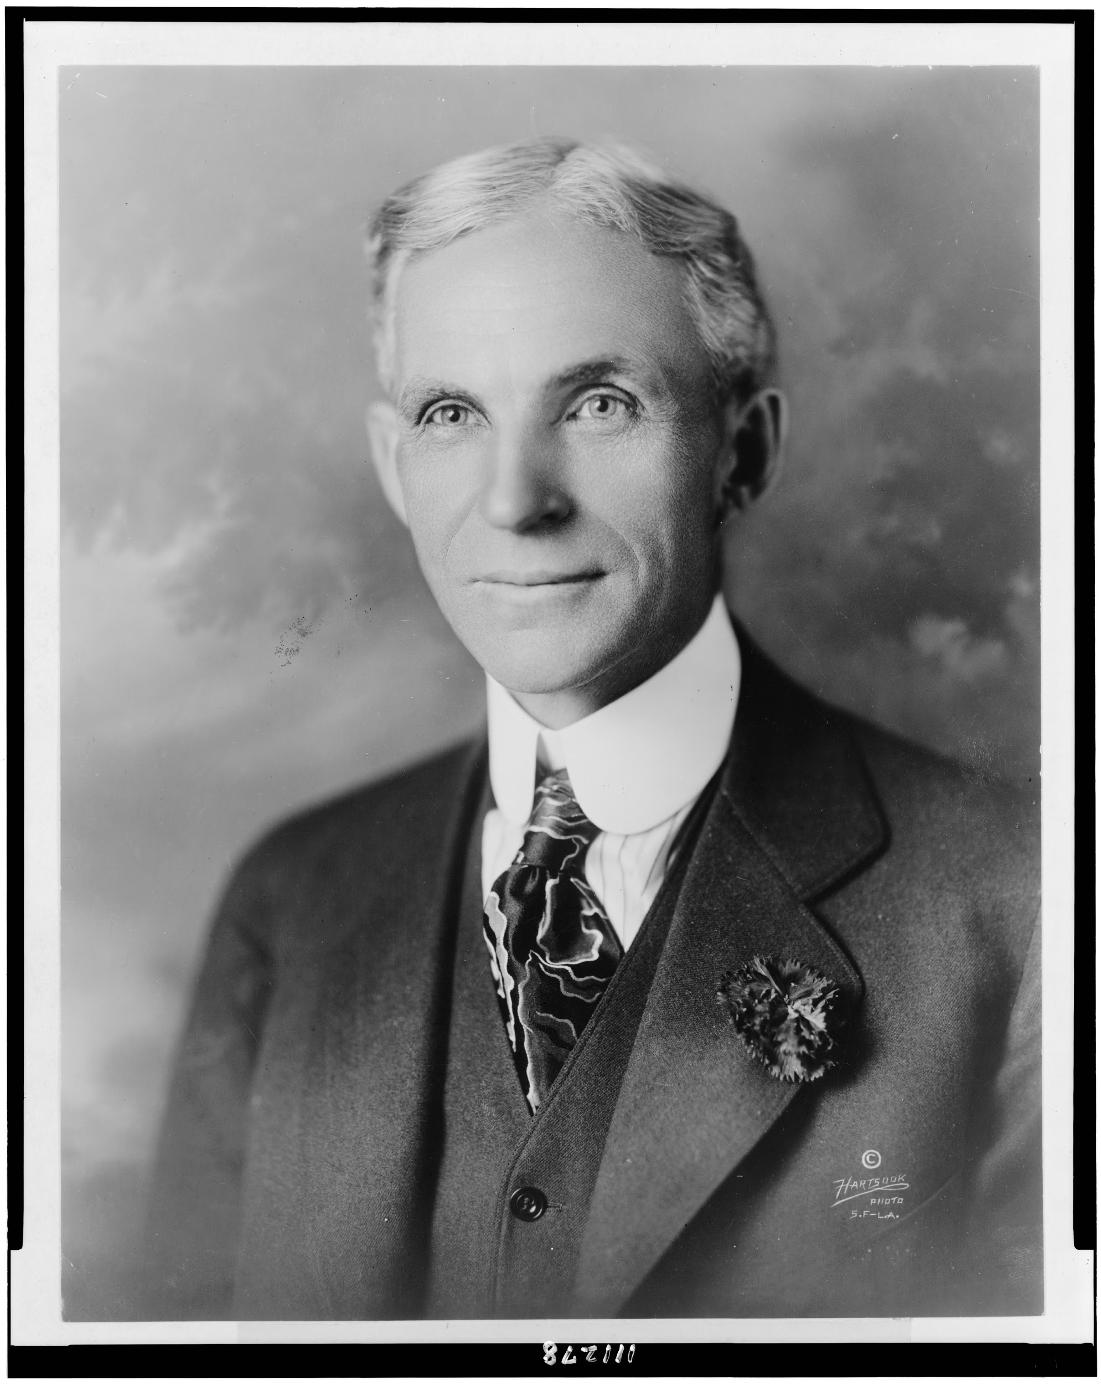
About Ford Motor Company
Ford Motor Company is an American automaker that is based out of Detroit.
It was founded by Henry Ford on June 16th, 1903.
Currently, there is about 199,000 employees at Ford worldwide.
The company sells automobiles and commercial vehicles under the Ford brand and most of its luxury cars are sold under the Lincoln brand.
Ford is the third largest automaker in the United States and the fourth largest automaker in the world.

Slide 4

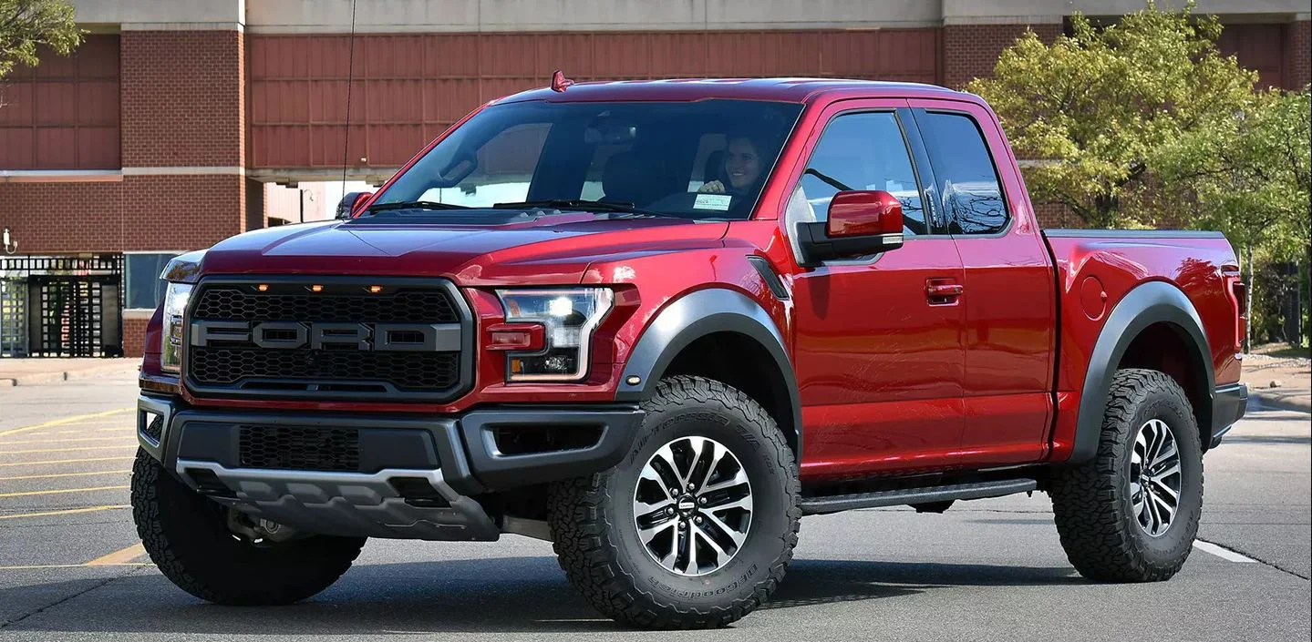
Automobile Industry
Worldwide:
In 2020, the worldwide automobile sales will reach 102 million units.
The largest automobile maker worldwide is Toyota.
U.S.:
In 2018, the U.S. automobile sales reached 17.2 million units, which is the second largest automobile market worldwide.
There are currently 293 different car models offered.
Currently, Toyota Rav4 is the best selling vehicle.
Ford’s top seller is it’s Ford F-150 pickup truck.
448,398 units were sold.

Slide 5
4Ps of Marketing
Place
Dealerships
Ford Motor Credit Company*
11,428 Ford/Lincoln dealerships around the world
About 3,000 in the United States
Auto Parts Stores
Ford's Website
Product
Automobiles
Trucks
Buses
Tractors
Parts/Components
Financial Services / Vehicle Leasing
Promotion
Advertising
Mostly television and online advertisements
Personal Selling
Direct Selling
Sales Promotions
Public Relations
Price
Market Oriented Pricing Strategy
Premium Pricing Strategy

Slide 6
SWOT Analysis
Strengths
Strong brand image
Global supply chain
Effective innovation process
Weaknesses
Limited global production network
Higher costs compared to competitors
Slow innovation processes
Opportunities
Global expansion through market penetration
Product development
Cost reduction through strategic supply chain management
Threats
Competitive rivalry
High tech firms
Fluctuating oil prices

Slide 7
Porter’s 5 Forces
Threat of New Entry - Low
High capital costs
High costs of brand development
Difficult entering into established industry
Competitive Rivalry - High
Compete against top companies that aggressively innovate their products
High exit barriers
Numerous competitors
Buyer Power – Relatively High
High level of customer preferences
Low switching costs
Customer make long term purchase
Supplier Power - Relatively Low
Large number of suppliers
Inputs are standardized
Easily switch between suppliers
Threat of Substitution - Low
Considerable substitutes are not available in certain area
Customers loyalty
Customers can’t easily switch due to car loans

Slide 8
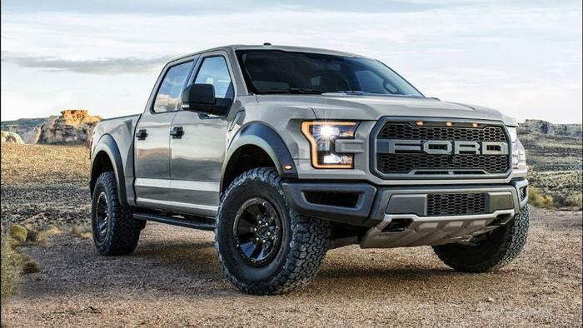
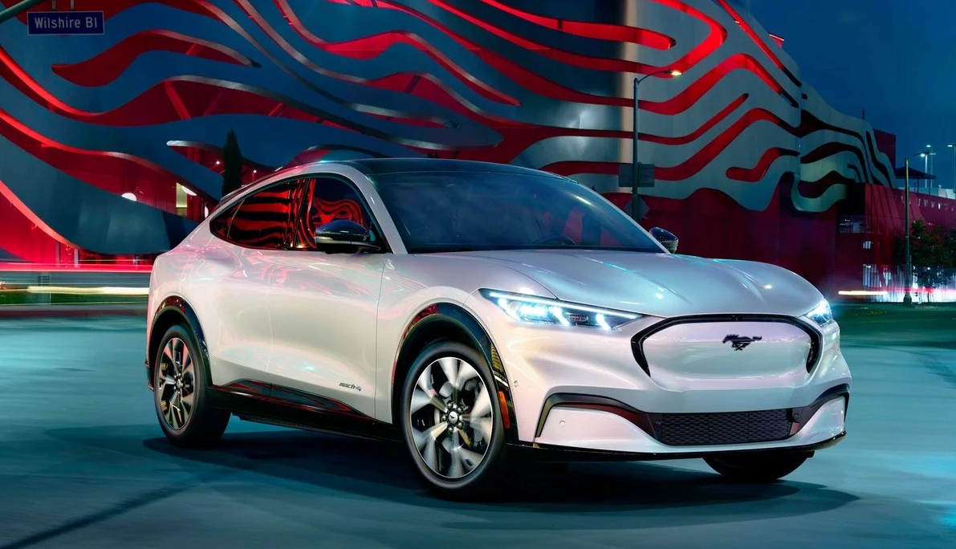
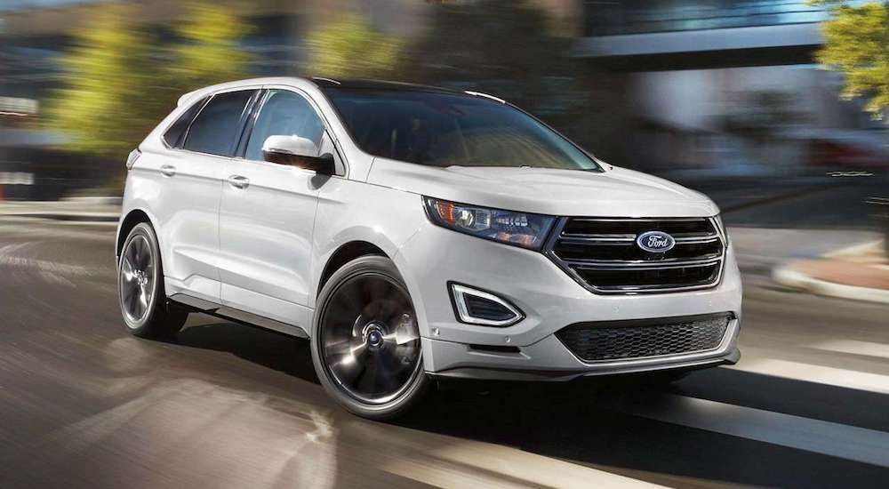
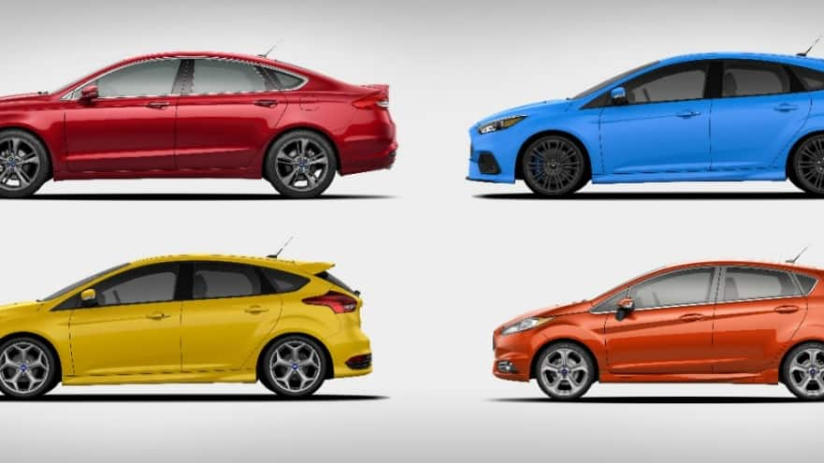

BCG Matrix
Stars
Question Marks
Cash Cows
Dogs
Our
Goal

Slide 9
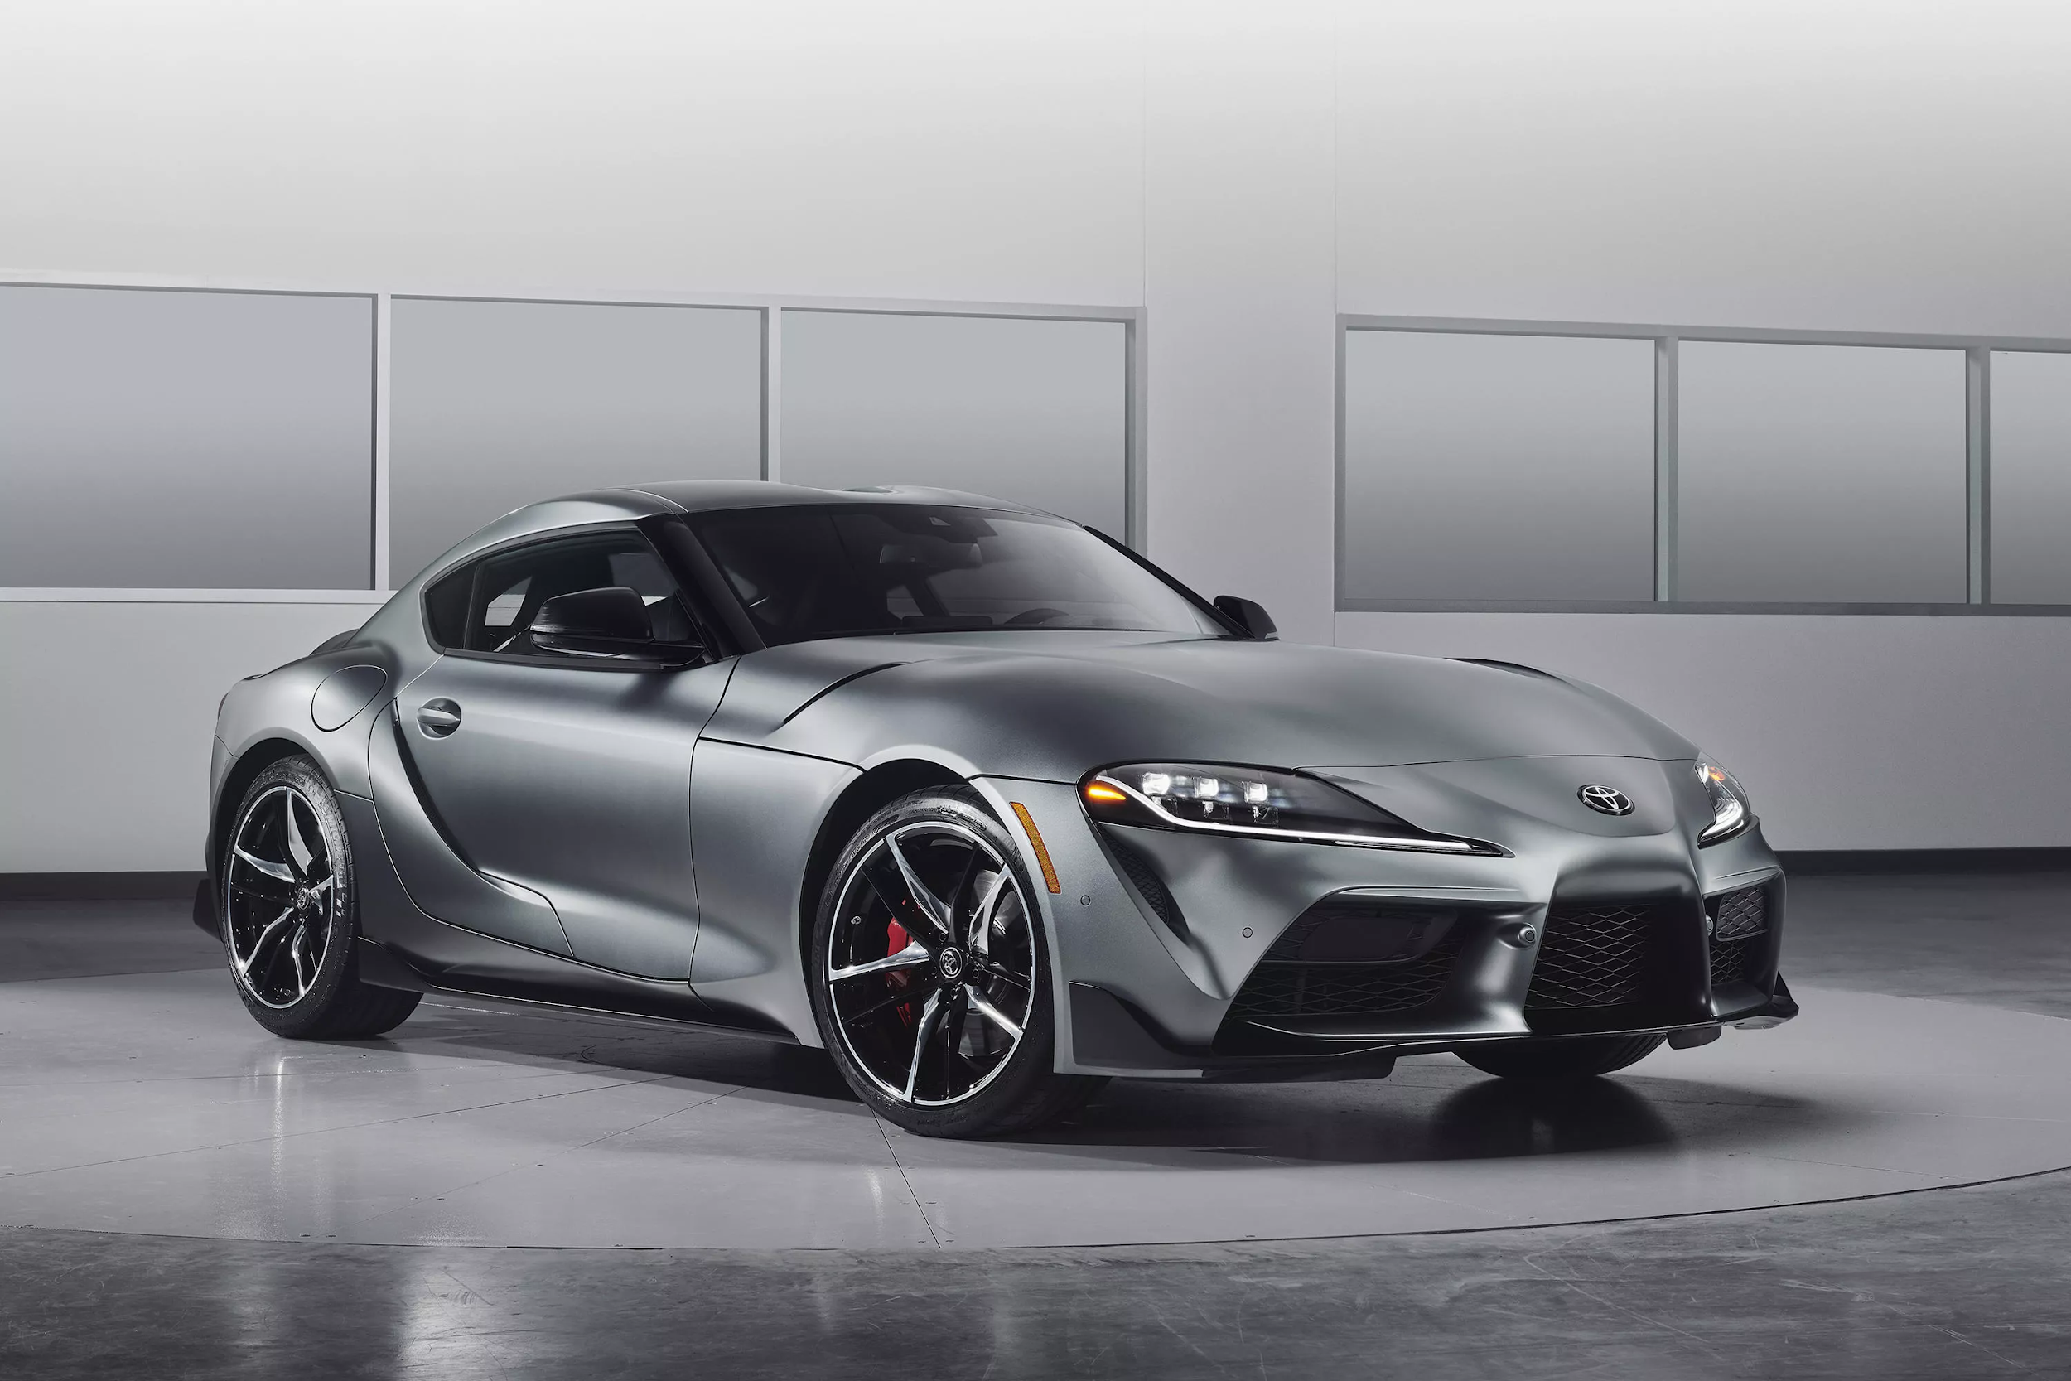
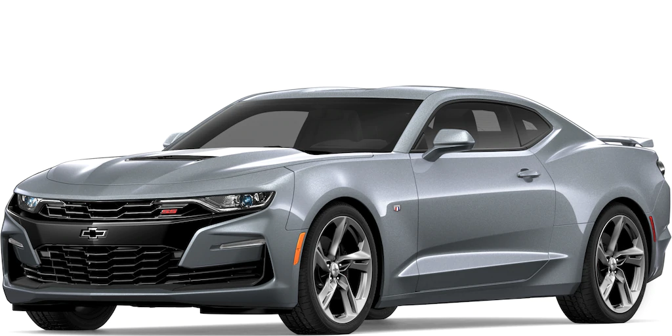
Competitors
Ford Motor Company vs. :
1.36 million cars sold last year.
Made 160.3 billion dollars in revenue.
General Motors:
The largest US automaker with 8.4 million cars sold last year.
Made 147 billion dollars in revenue.
Competitor Car: Chevrolet Camaro
Toyota :
The largest global automaker with 9.6 million cars sold
Made 276.2 billion dollars in revenue.
Competitor Car: Toyota Supra/Toyota 86

Slide 10
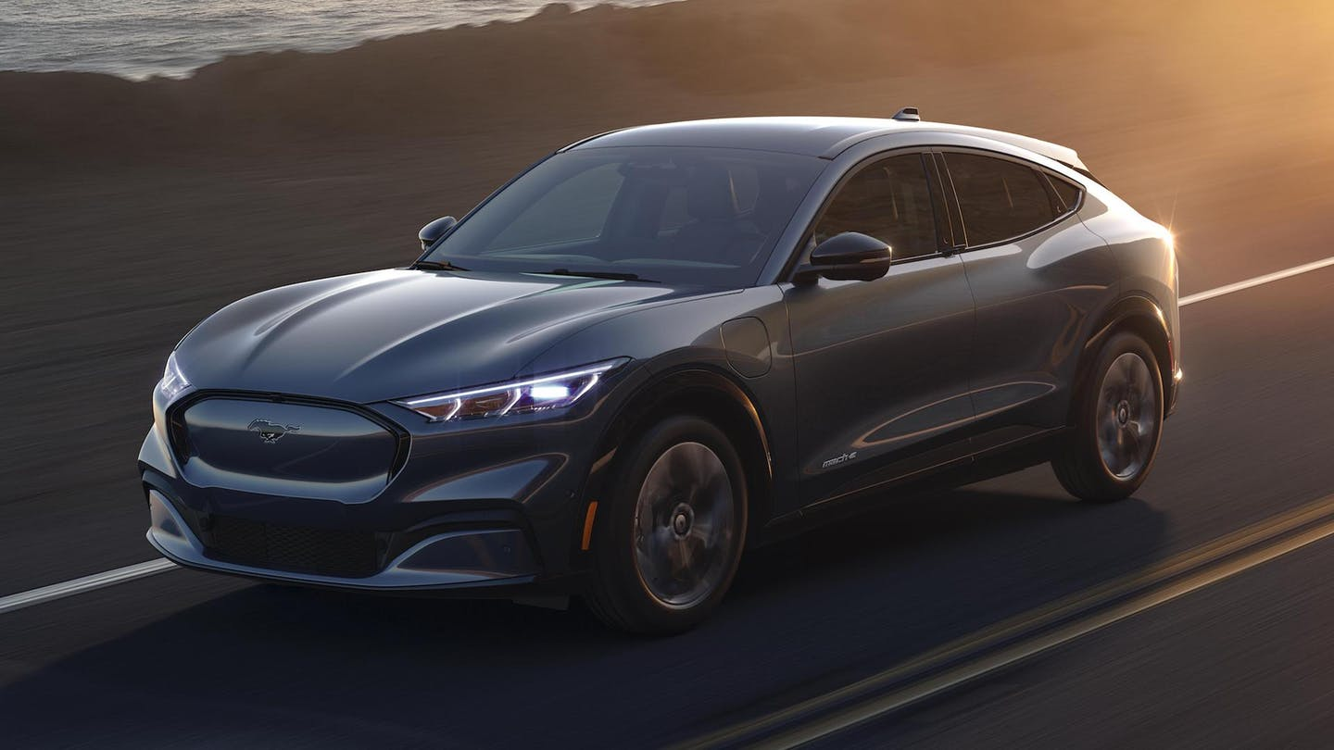
2021 Ford Mustang Mach-E electric SUV

Slide 11
About the 2021 Ford Mustang Mach-E electric SUV
Mustang Mach-E GT Performance Edition
459 horsepower, from two electric motors, one powering the back wheels, the other powering the front.
Zero to 60 miles an hour in roughly 3.5 seconds(a time similar to a Porsche 911 GTS)
Ability for hands-free driving on the highway
The charger network will have over 12,000 charging stations.
Can seat up to four people
Est. MSRP Starting at $60,000.(Performance Edition)

Slide 12
2021 Ford Mustang Mach-E vs. Audi E-Tron, Jaguar I-Pace and Tesla Model 3
DIMENSIONS
Model | Length (in) | Width (in) | Height (in) | Wheelbase (in) | Rear cargo space (cu-ft) | Front cargo space (cu-ft)
Audi E-Tron | 193 | 76.3 | 65.5 | 115.1 | 28.5 | Some
Ford Mustang Mach-E | 186 | 74 | 63 | 117 | 29 | 4.8
Jaguar I-Pace | 184.3 | 74.6 | 61.3 | 117.7 | 25.3 | Some
Tesla Model 3 | 184.8 | 72.8 | 56.8 | 113.2 | 12 | 3

Slide 13
Model | Battery size (kWh) | Max range (mi, US est.) | Number of electric motors | Motor locations | Battery location
Audi E-Tron | 95 | 204 | 2 | Front, rear axles | Floor
Ford Mustang Mach-E (SR) | 75.7 | 210-230 (est.) | 1-2 | Front, rear axles | Floor
Ford Mustang Mach-E (ER) | 98.8 | 235-300 (est.) | 1-2 | Front, rear axles | Floor
Jaguar I-Pace | 90 | 234 | 2 | Front, rear axles | Floor
Tesla Model 3 Standard Range Plus | 54 | 250 | 1 | Rear axle | Floor
Tesla Model 3 Performance | 75 | 310 | 2 | Front, rear axles | Floor
Powertrain

Slide 14
PERFORMANCE
Model | Power (hp) | Torque (lb-ft) | Acceleration, 0-60mph (sec) | Top speed (mph) | Drag coefficient
Audi E-Tron | 355 (402 overboost) | 414 (490 overboost) | 5.5 | 124 | 0.3
Ford Mustang Mach-E (ER AWD) | 332 (est.) | 417 (est.) | 5.5 (est.) | TBA | TBA
Ford Mustang Mach-E GT Performance | 459 (est.) | 612 (est.) | 3.5 (est.) | TBA | TBA
Jaguar I-Pace | 394 | 512 | 4.5 | 124 | 0.29
Tesla Model 3 Standard Range Plus | 283 (est.) | 307 (est.) | 5.3 | 140 | 0.23
Tesla Model 3 Performance | 473 (est.) | 471 (est.) | 3.2 | 162 | 0.23

Slide 15
PRICE
Model | Lineup starting price
Audi E-Tron | $74,800
Ford Mustang Mach-E | $40,000 to $50,000 (est.)
Jaguar I-Pace | $69,500
Tesla Model 3 | $39,490

Slide 16
Audiences
Primary Target Audience:
Gender: Males
Age: 25-35 years old
Single/Unmarried Men
Annual Income: > $40,000
Location: Metropolitan Areas
Looking to impress with a stylish and sporty car that is also fuel efficient
Secondary Target Audience:
Gender: Males
Age: 36-50 years old
Annual Income: > $70,000
Married with kids.
Location: Metropolitan Areas
Looking at a car that is fuel efficient, good for a family but still sporty for himself; believe in the Mustang dream/history; muscle car fan

Slide 17
Business/Marketing Objective
Marketing Objective :
Enhance brand awareness
Increase sales of the Mustang in 2020
Moving the company from a -10.1% to 0% in sales.
Selling 6,000 units in the U.S.
Aim to reach at least 70% of our primary target customers through social media channels
Can measure this goal by the number of people that client on the ads to inquire about the Mustang
Talk to 10,000 people in the dealership
Can measure this goal by the number of people that come to the dealership that come in to test drive the car.
Notes:
Reasons:
US auto market continues to growth
Limited new car models available in the market
The Mustang was the best-selling sports car in the U.S. in 2018
Stable demand for new cars

Slide 18
Current Marketing Strategy
Current Marketing Budget:
$14 billion
Ford executives pointed to several areas of its marketing strategy that need to be addressed:
This includes improving digital capabilities and ROI (Return on Investment) on media and better optimizing yield management in incentives programs through regionalization and personalization.
Ford executives made the decision to stop selling most sedans comes as consumers are opting for larger vehicles, like pickups, SUVs and crossovers, which are more profitable for the company.

Slide 19
Recommended Marketing Strategy
Key Marketing Strategy: Social Media
Use social media to support media advertisement, sales promotions and news
Key Elements:
Creating an official account for the Mustang on Instagram and Youtube
There are official accounts for the Mustang on Twitter and Facebook.
Encourage users to tag Ford in their pictures
Monitor comments and activities on social media
Create hashtags for:
#mustang
#mustangmach
#mustangelcetric
Place display ads on social media for users that research Ford Mustang or Ford Performance

Slide 20
Recommended Marketing Strategy
Another Marketing Strategy: Traditional channels
Key Elements:
Print Media - Magazines and Newspapers
Appear in auto section of newspapers
Appear in popular car magazines
Events
Appear at the regional auto shows
- Television and radio commercials:
Appear on ABC, FOX and NBC channels during news programming

Slide 21
Marketing Budget and Timeline
Total Ford’s Marketing Budget:
$14 billion
Our Marketing Budget:
5% of total Mustang Ecoboost Fastback sales
Timeline - Social Media
December 10th 2019: Create official accounts on Instagram and Youtube.
December 12th 2019: First post on Instagram and Youtube.
December 13th 2019 - December 31st 2020:
One post per day on Instagram
One video per week on Youtube
Timeline - Traditional Channels
January 1st 2020 - December 31st 2020:
Place two advertisement every month in Auto Magazine
Place three advertisements every month in Newspaper
Place one advertisement every quarter on TV channels
April 2020:
Attend New York International Auto show

Slide 22
Future Strategy
Enter Latin American and asian markets with hybrid cars
Develop affordable electric cars for us market
Manufacture of new small fuel efficient vehicle
Reduce manufacturing expenses by 15-20%

Slide 23
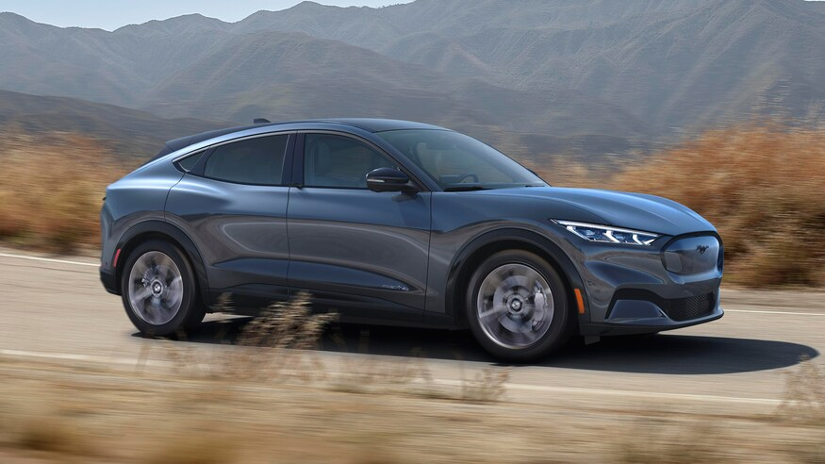
Conclusion
Our primary marketing strategy is to expand our social media presence to be able to increase sales of the 2021 Ford Mustang Mach-E electric SUV

